Slide 1
Descriptive complexity and inexpressibly proofs
Ron Fagin
IBM Almaden Research Center
San Jose, CA

Slide 2
Complexity Theory
Traditional focus: computational complexity
Amount of resources such as time or space, required by a machine that solves the problem
More recent branch of complexity theory (and finite model theory): descriptive complexity
Complexity of describing properties in some logical formalism

Slide 3
Descriptive Complexity
Examples
Which logic can capture a given property?
First-order logic
Fixpoint logic
Second-order logic
In a given logic (say, first-order logic), how complex a formula is required to capture the property?
Quantifier depth?
How many quantifiers?
How many variables?

Slide 4
Descriptive Complexity (contd.)
There is an intimate connection between
computational complexity and
descriptive complexity in finite model theory

Slide 5
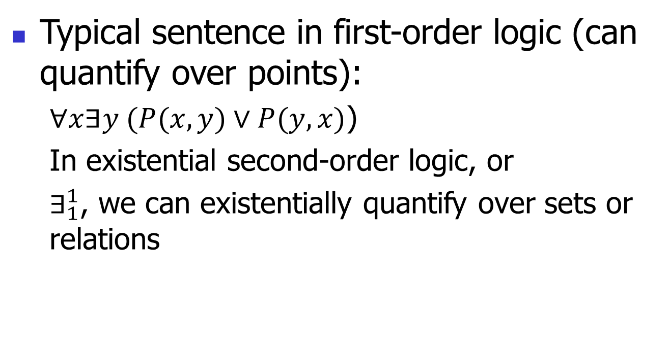
First-order logic vs. existential second-order logic
Typical sentence in first-order logic (can quantify over points):
$∀x∃y (P(x,y)∨P(y,x)$)
In existential second-order logic, or
$∃_{1}^{1}$, we can existentially quantify over sets or relations

Slide 6
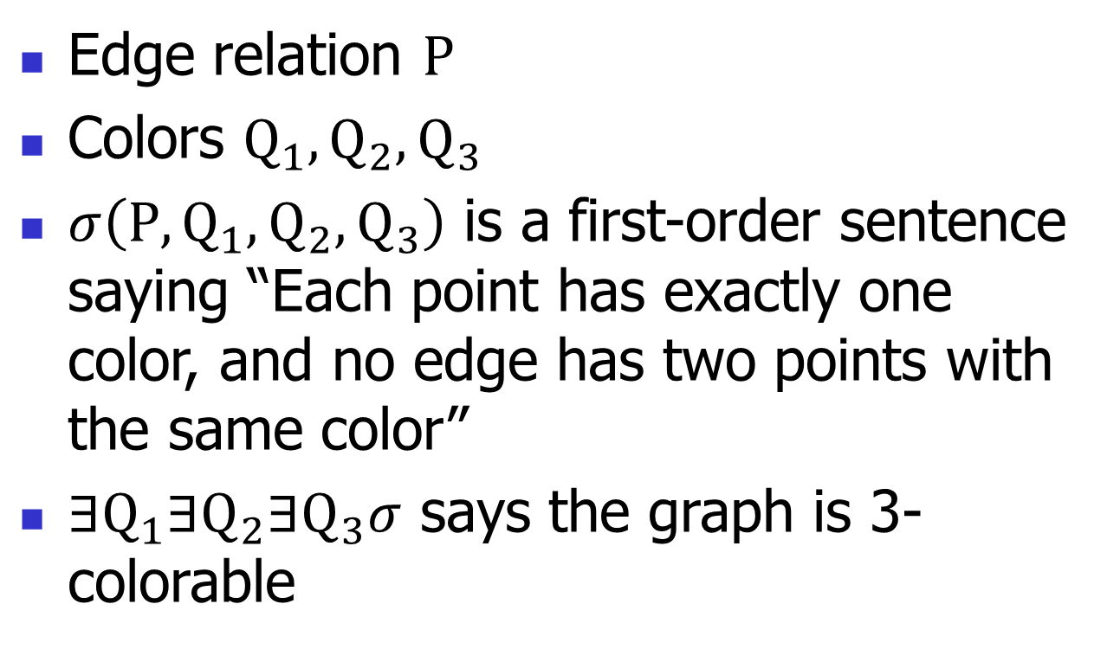

$Σ_{1}^{1}$ example: 3-colorability
Edge relation $P$
Colors $Q_{1},Q_{2},Q_{3}$
$σ\left(P, Q_{1}, Q_{2}, Q_{3}\right)$ is a first-order sentence saying “Each point has exactly one color, and no edge has two points with the same color”
$∃Q_{1}∃Q_{2}∃Q_{3}σ$ says the graph is 3-colorable

Slide 7
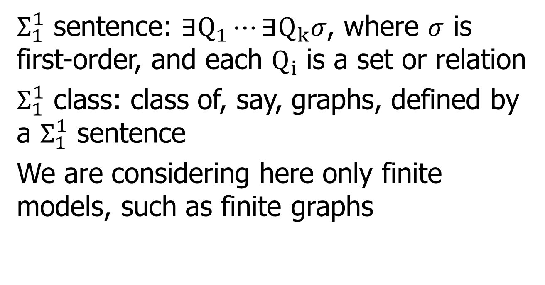

$Σ_{1}^{1}$ Class
$Σ_{1}^{1}$ sentence: $∃Q_{1}⋯∃Q_{k}σ$, where $σ$ is first-order, and each $Q_{i}$ is a set or relation
$Σ_{1}^{1}$ class: class of, say, graphs, defined by a $Σ_{1}^{1}$ sentence
We are considering here only finite models, such as finite graphs

Slide 8
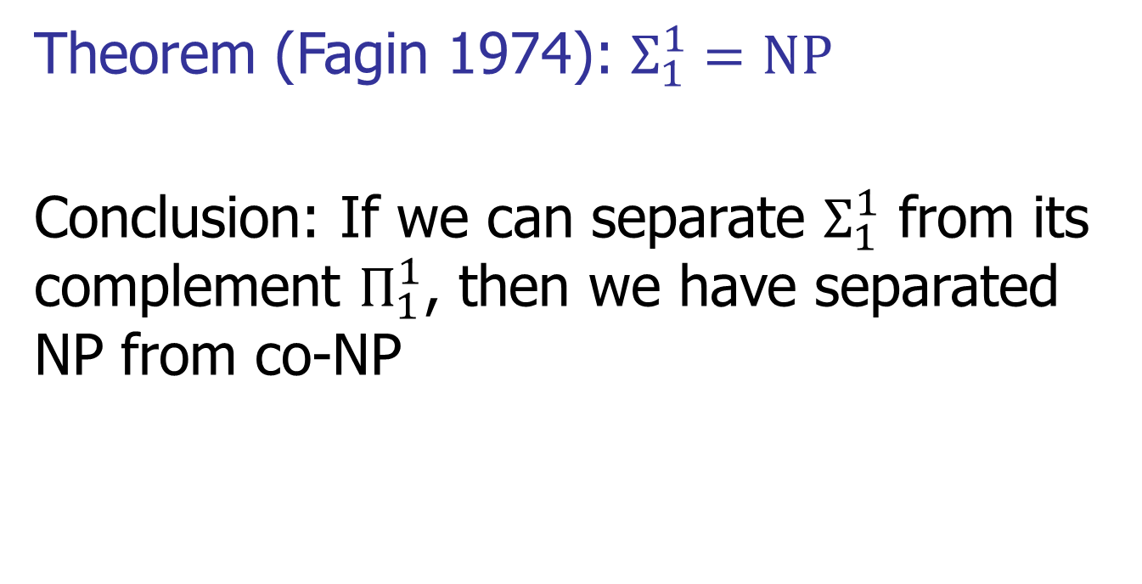
Theorem (Fagin 1974): $Σ_{1}^{1}=NP$
Conclusion: If we can separate $Σ_{1}^{1}$ from its complement $Π_{1}^{1}$, then we have separated NP from co-NP

Slide 9
Our motivation
This motivates developing techniques for proving inexpressibility results (and hence separation results) in finite model theory

Slide 10
Tools to Prove Inexpressibility Results in Logic
Finite case:
Compactness Theorem
Löwenheim-Skolem Theorem
Ehrenfeucht-Fraïssé games

Slide 11
Purpose of This Talk
Discuss results and techniques that assist in the use of Ehrenfeucht-Fraïssé games
to make easier the task of proving inexpressibility results

Slide 12
1st-Order Ehrenfeucht-Fraïssé Game
r-game between Spoiler and Duplicator
1
3
2
2
1
3

Slide 13

1st-Order Ehrenfeucht-Fraïssé Game
r-game between Spoiler and Duplicator
1
3
2
2
1
3
If Duplicator has winning strategy, write $G_{0} \sim _{r}$ $G_{1}$

Slide 14
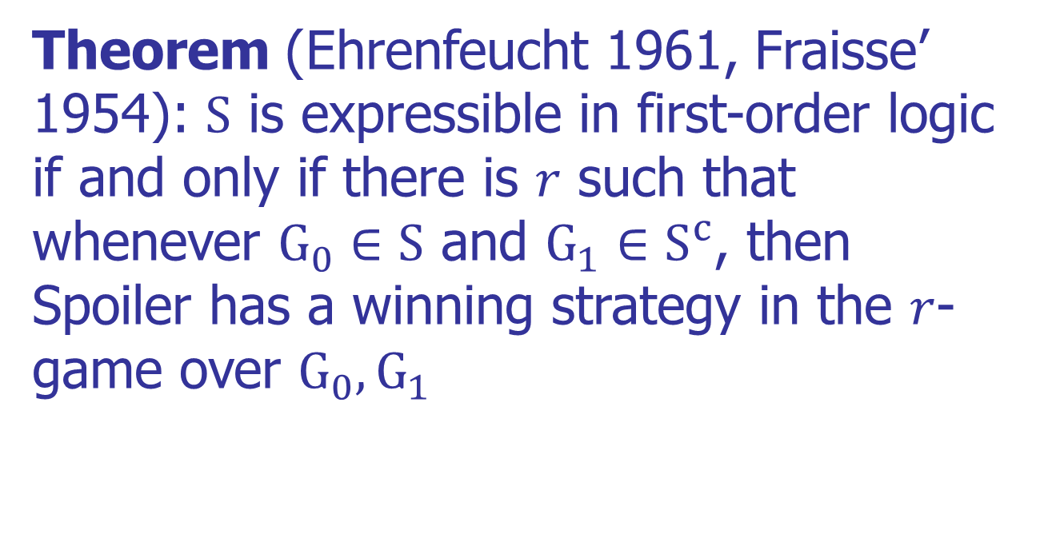
Importance of Ehrenfeucht-Fraïssé Games
Theorem (Ehrenfeucht 1961, Fraisse’ 1954): $S$ is expressible in first-order logic if and only if there is $r$ such that whenever $G_{0}∈S$ and $G_{1}∈S^{c}$, then Spoiler has a winning strategy in the $r$-game over $G_{0},G_{1}$

Slide 15
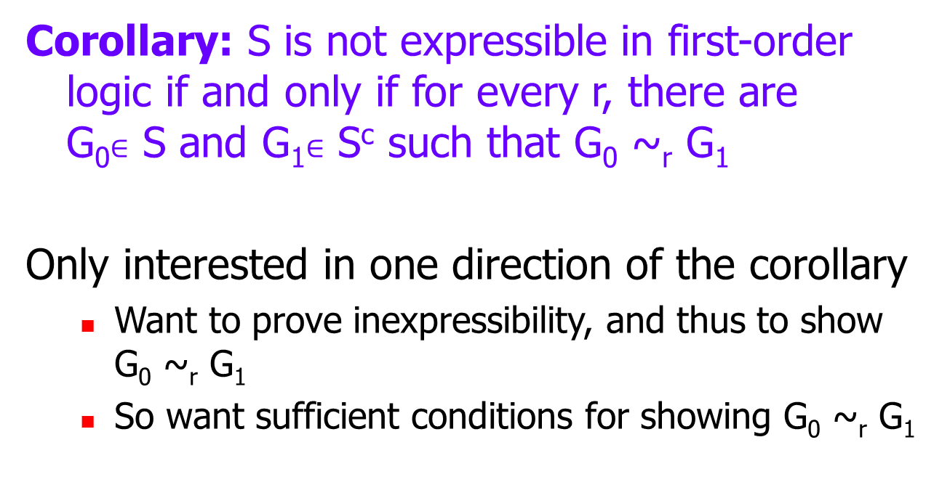
Importance of Ehrenfeucht-Fraïssé Games (contd.)

Slide 16
Hanf’s Technique
d-type of a point a: isomorphism type of (open) neighborhood of radius d about a
G₀ and G₁ are d-equivalent if for every d-type τ, both G₀ and G₁ have the same number of points of d-type τ
d = 3
3
2
1
1
1
1

Slide 17
Hanf’s Theorem
Theorem (essentially Hanf 1965): Let r be a positive integer. There is a positive integer d such that whenever G₀ and G₁ are d-equivalent, then G₀ ~_{r} G₁
d-equivalence is a type of local isomorphism
Can weaken assumption of d-equivalence to say that for every d-type τ, either G₀ and G₁ have the same number of points of d-type τ, or both have many points with d-type τ
Example: one sufficiently big cycle versus two sufficiently big cycles

Slide 18
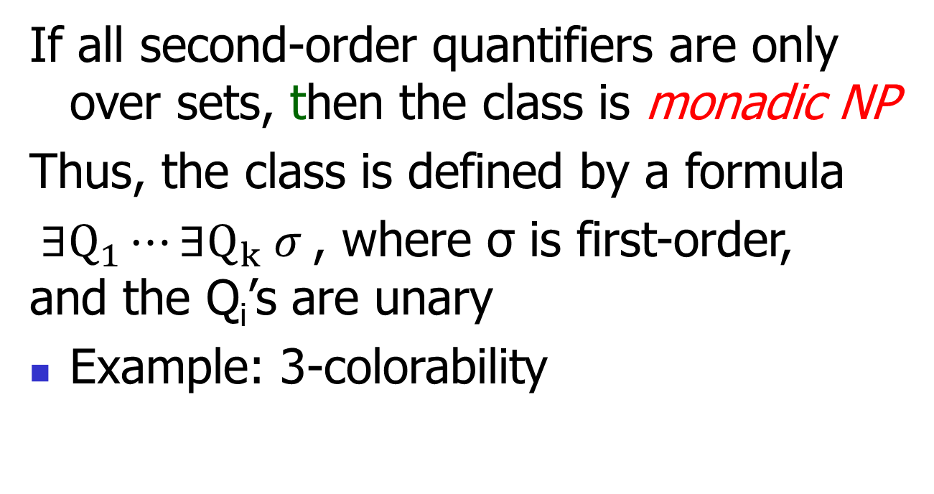
Monadic NP

Slide 19
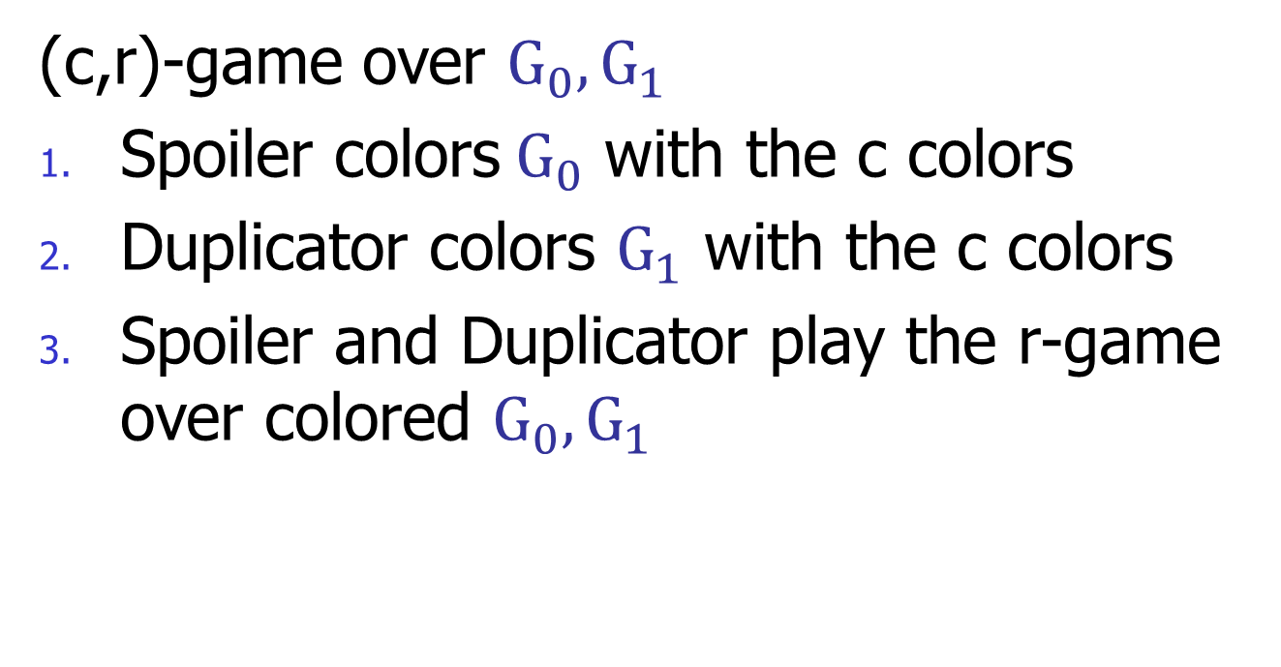
Capturing Monadic NP by games
(c,r)-game over $G_{0}, G_{1}$
Spoiler colors${ G}_{0}$ with the c colors
Duplicator colors $G_{1}$ with the c colors
Spoiler and Duplicator play the r-game over colored $G_{0}, G_{1}$

Slide 20
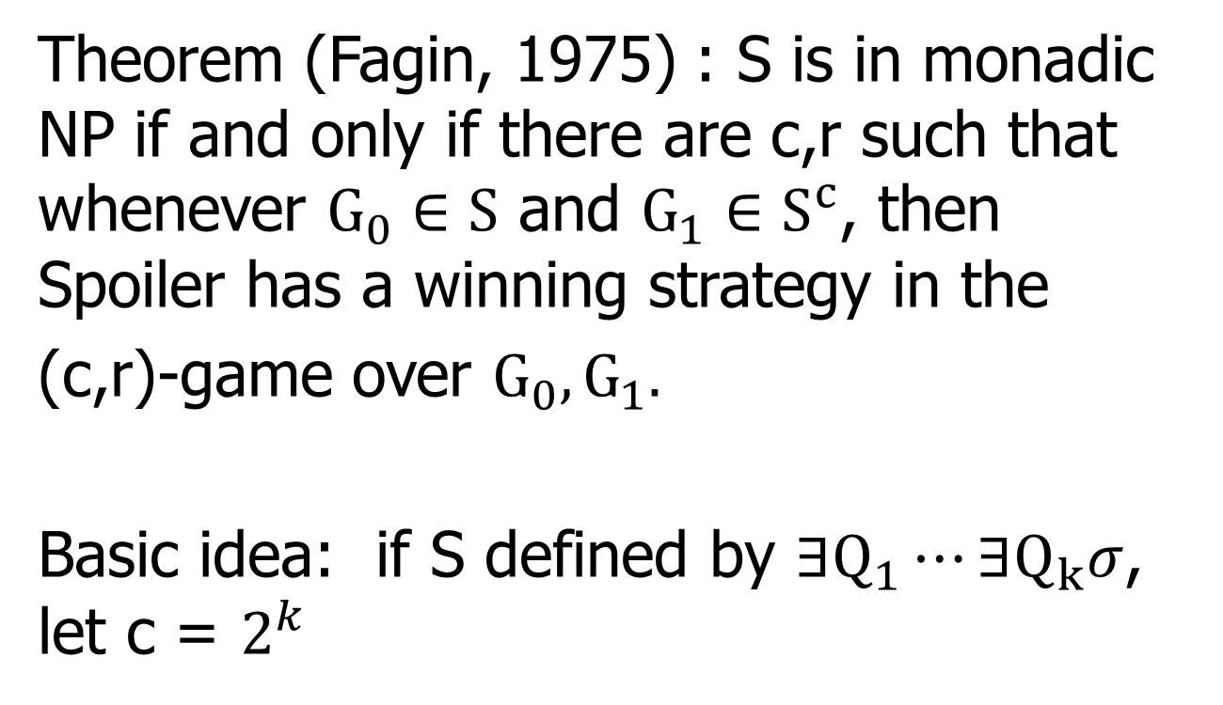
Theorem (Fagin, 1975) : S is in monadic NP if and only if there are c,r such that whenever $G_{0}∈S$ and $G_{1}∈S^{c}$, then Spoiler has a winning strategy in the
(c,r)-game over $G_{0},G_{1}.$
Basic idea: if S defined by $∃Q_{1}⋯∃Q_{k}σ$, let c = $2^{k}$

Slide 21
Theorem (Fagin 1975): Connectivity is not in monadic NP
Original proof:

Slide 22
Showed that given c, r, there are cycles C₀, C₁ such that
if G₀ = C₀ and G₁ = C₀ + C₁, then Duplicator can win the
(c, r)-game over G₀, G₁
c₀
c₀
c₁

Slide 23
Duplicator's coloring strategy: color C₀ in G₁by mimicking the
coloring of C₀ in G₀, and color C₁ in a way where every d-type
in C₁ appears many times in C₀
c₀
c₀
c₁

Slide 24
Duplicator's coloring strategy: color C₀ by mimicking the
coloring of G₀, and color C₁ in a way where every d-type
in C₁ appears many times in C₀
c₀
c₀
c₁

Slide 25
Duplicator's coloring strategy: color C₀ by mimicking the
coloring of G₀, and color C₁ in a way where every d-type
in C₁ appears many times in C₀
c₀
c₀
c₁

Slide 26
Duplicator’s pebbling strategy: given explicitly
Note: for pebbling strategy, could have used the
extended Hanf condition
c₀
c₀
c₁

Slide 27
Difficulties in Original Proof
Selection of graphs
Duplicator’s coloring strategy
Duplicator’s pebbling strategy

Slide 28
Changing Rules of the Game
(c, r)-game over class S of graphs:
Duplicator selects member of S to be G₀
Duplicator selects member of S^{c} to be G₁
Spoiler colors G₀ with the c colors
Duplicator colors G₁ with the c colors
Spoiler and Duplicator play r-game on colored G₀ and G₁

Slide 29
Ajtai-Fagin Game
Ajtai-Fagin (c, r)-game over class S of graphs:
Duplicator selects member of S to be G₀
Spoiler colors G₀ with the c colors
Duplicator selects member of S^{c} to be G₁
Duplicator colors G₁ with the c colors
Spoiler and Duplicator play r-game on colored G₀ and G₁
This game still characterizes monadic NP
Theorem (Ajtai and Fagin 1990): S is in monadic NP if and only if there are c, r such that Spoiler has a winning strategy in the Ajtai-Fagin (c, r)-game over S

Slide 30
Ajtai-Fagin Game (contd.)
Ajtai and I used Ajtai-Fagin games to prove that directed s-t connectivity is not in monadic NP
We did not see how to use Fagin games to prove that directed s-t connectivity is not in monadic NP
Remark: undirected s-t connectivity is in monadic NP

Slide 31
Ajtai-Fagin Game (contd.)
The Ajtai-Fagin game is “easier for Duplicator to win”
This makes our inexpressibility proofs easier
In fact, can prove (Fagin 1995) that in a precise sense, the game is easier for Duplicator to win (Spoiler requires more colors to win)

Slide 32
Moshe suggestion to Ron
“Let’s try to use Ajtai-Fagin games to get an easier proof that connectivity is not in monadic NP”

Slide 33
Simpler Proof Using Our Tools
Theorem: Connectivity is not in monadic NP
Proof (Fagin, Stockmeyer, and Vardi 1995): If in monadic NP, take c, r such that Spoiler wins Ajtai-Fagin (c, r)-game over the class of connected graphs.
Find d as in Hanf’s Theorem
Let G₀ be “big” directed cycle; let Spoiler color G₀

Slide 34
Since G₀ is big, there are two points a and b
at least 2d apart with the same d-type
a
G₀
b

Slide 35
Duplicator selects and colors G₁
a
G₀
b
a
G₁
b
Duplicator can now win, by Hanf’s Theorem!

Slide 36
How Proof has been Simplified
Selection of graphs
Simply pick G₀ to be large enough cycle
Duplicator’s coloring strategy
Simply mimic Spoiler’s coloring
Duplicator’s pebbling strategy
Appeal to Hanf

Slide 37
Corollary
Corollary: Monadic NP is not closed under complement
Proof: Non-connectivity is in monadic NP, via “There is a set S where S and its complement are nonempty, and there is no edge from a member of S to a member of its complement”

